Slide 1

USER PERSONA
Afroz Dar
Morganne Horsford
Ricardo Deodutt
Tuwanna Vassell

Slide 2
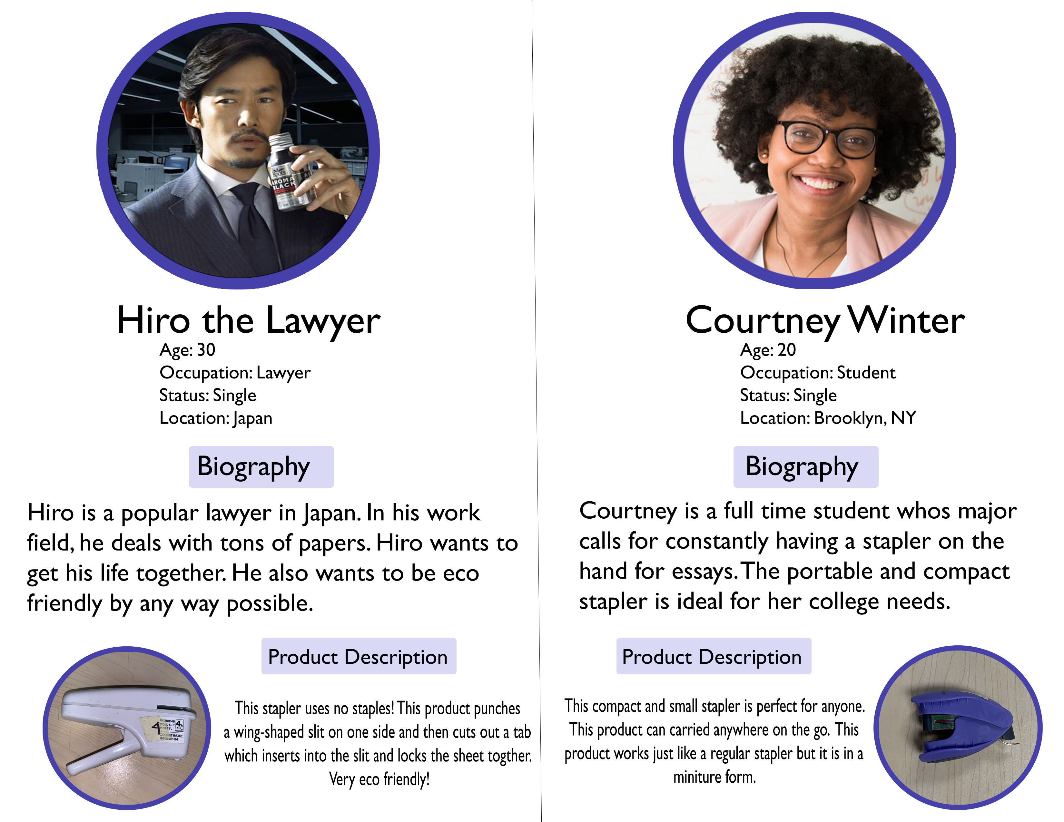

Slide 3
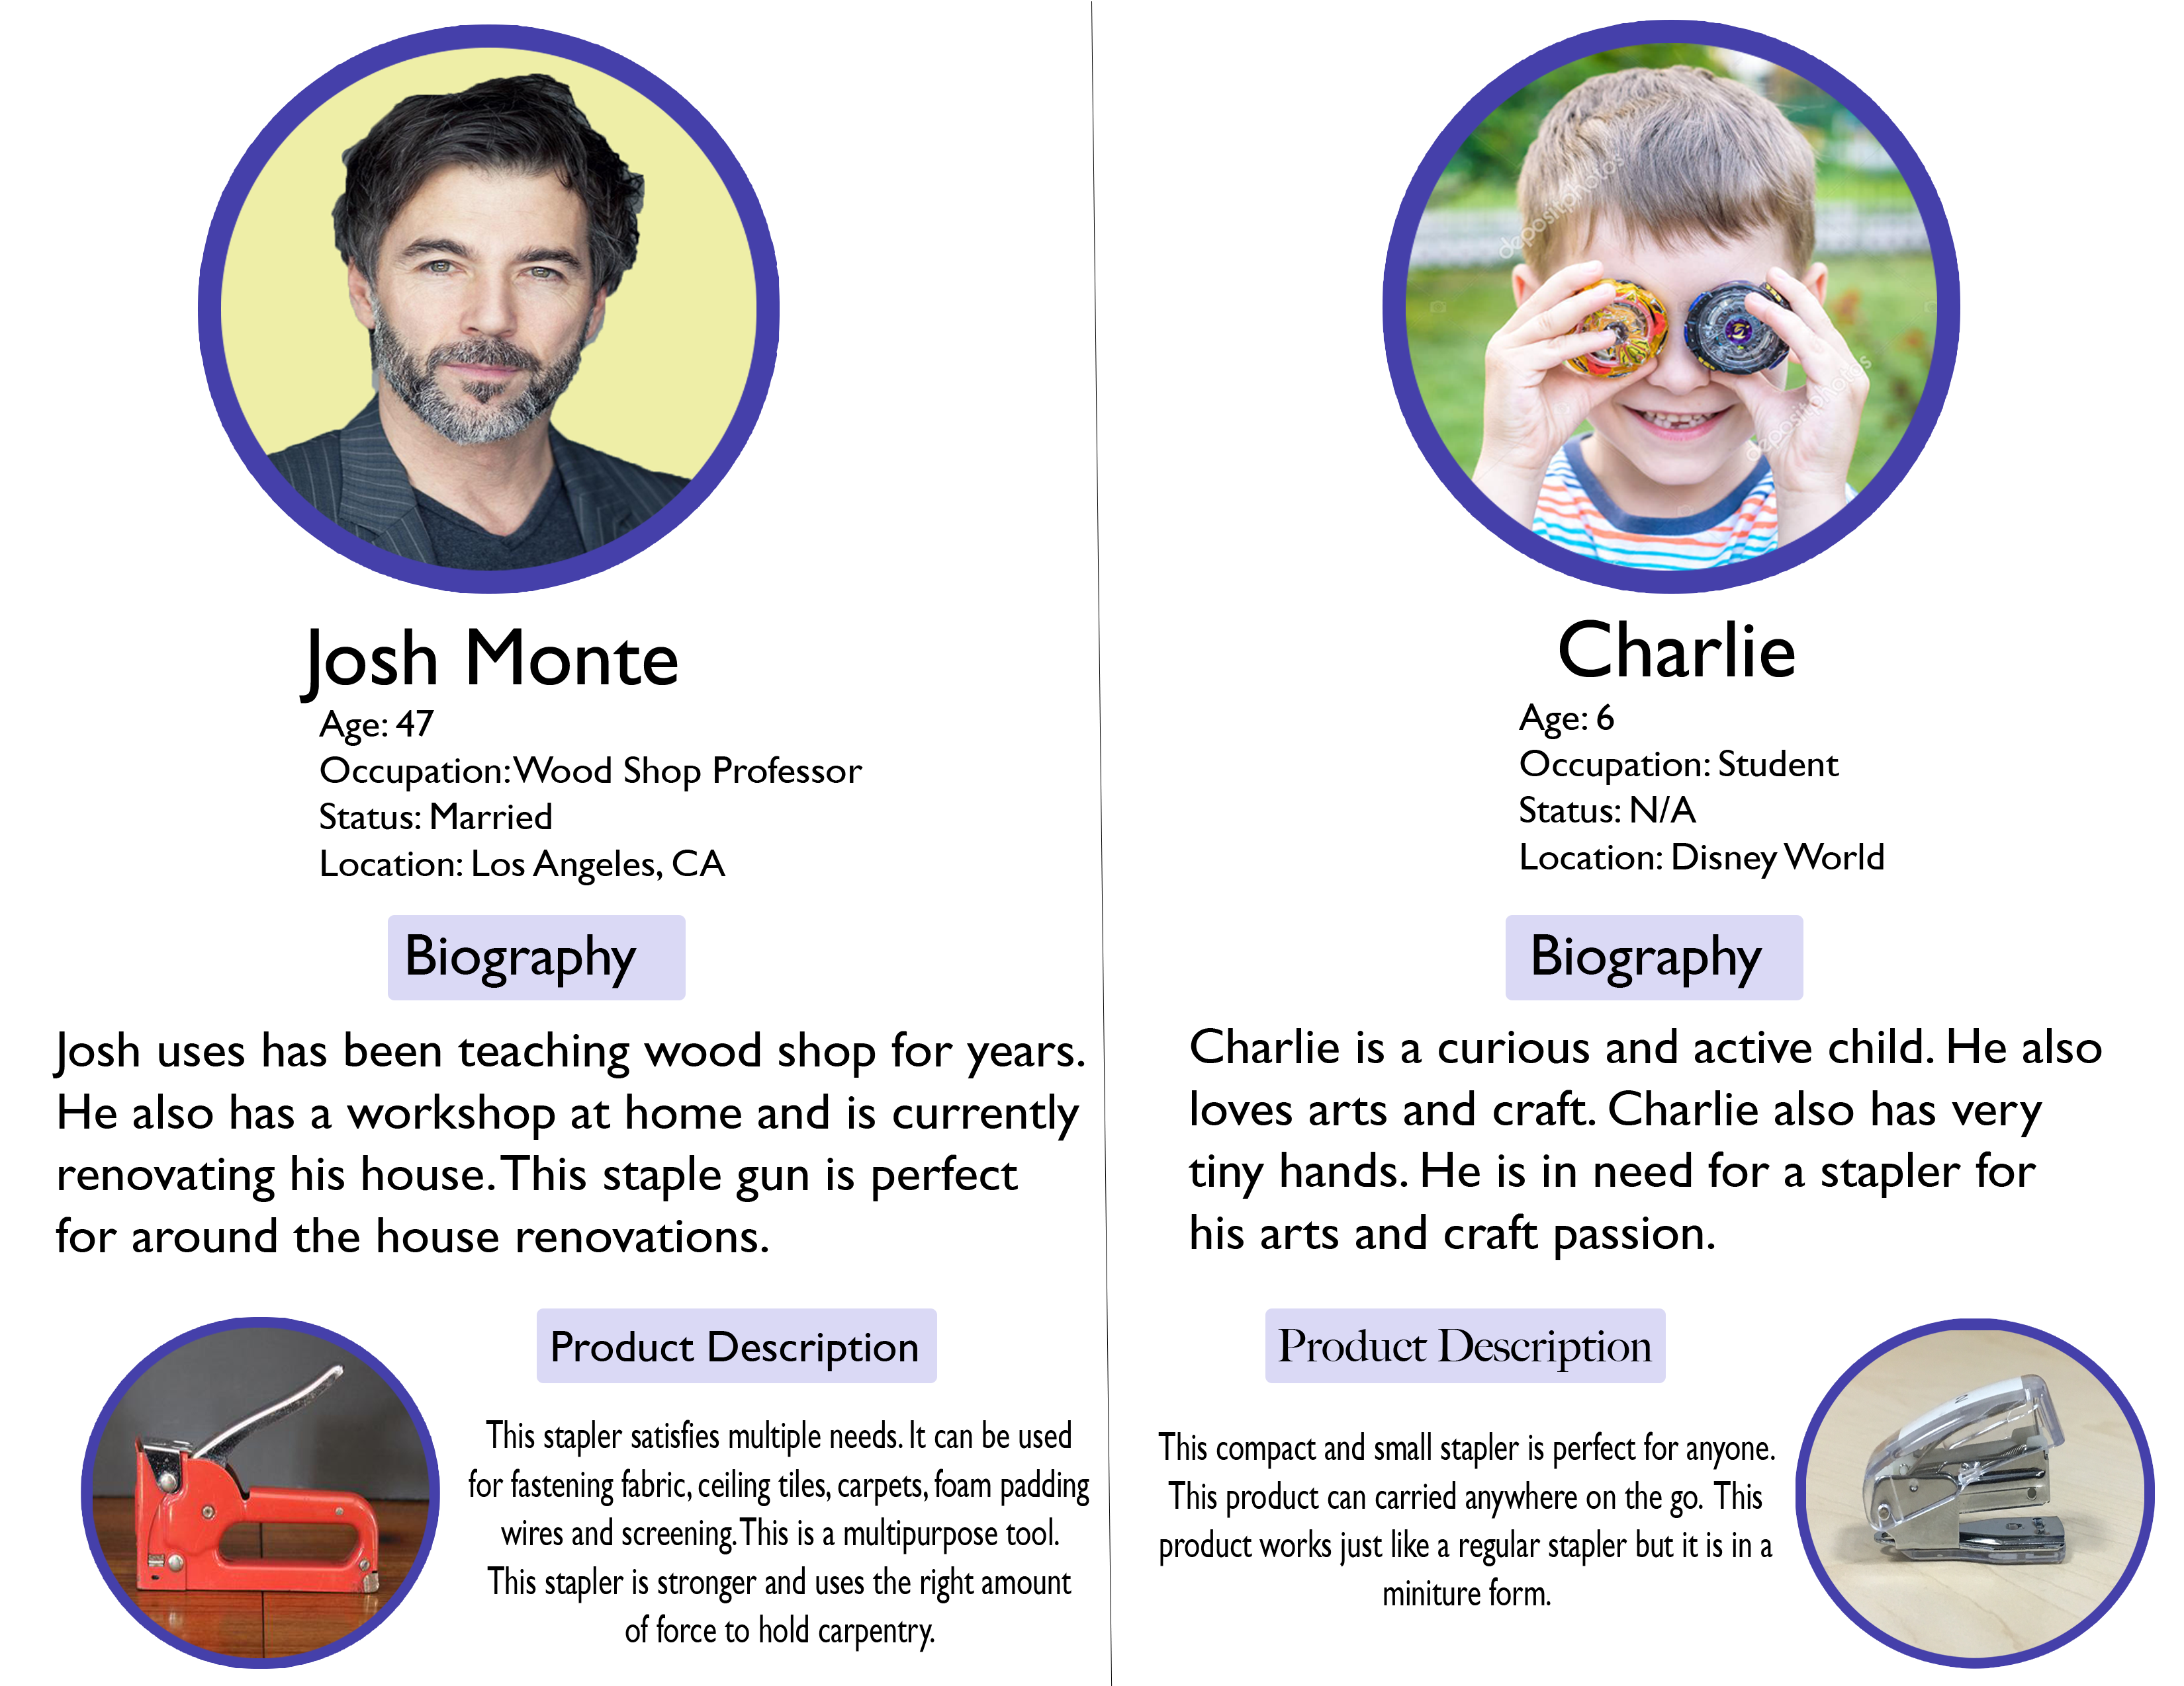

Slide 4
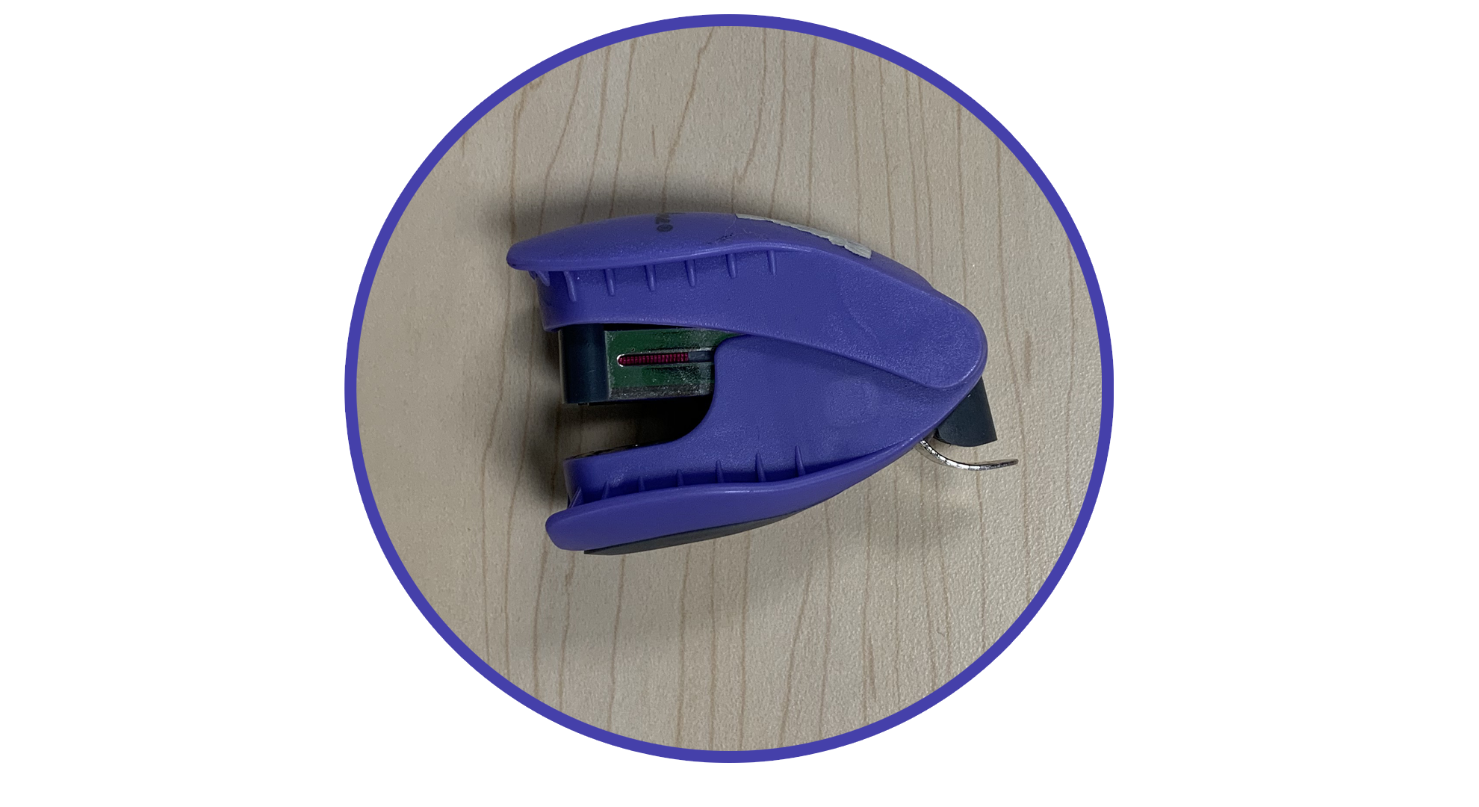
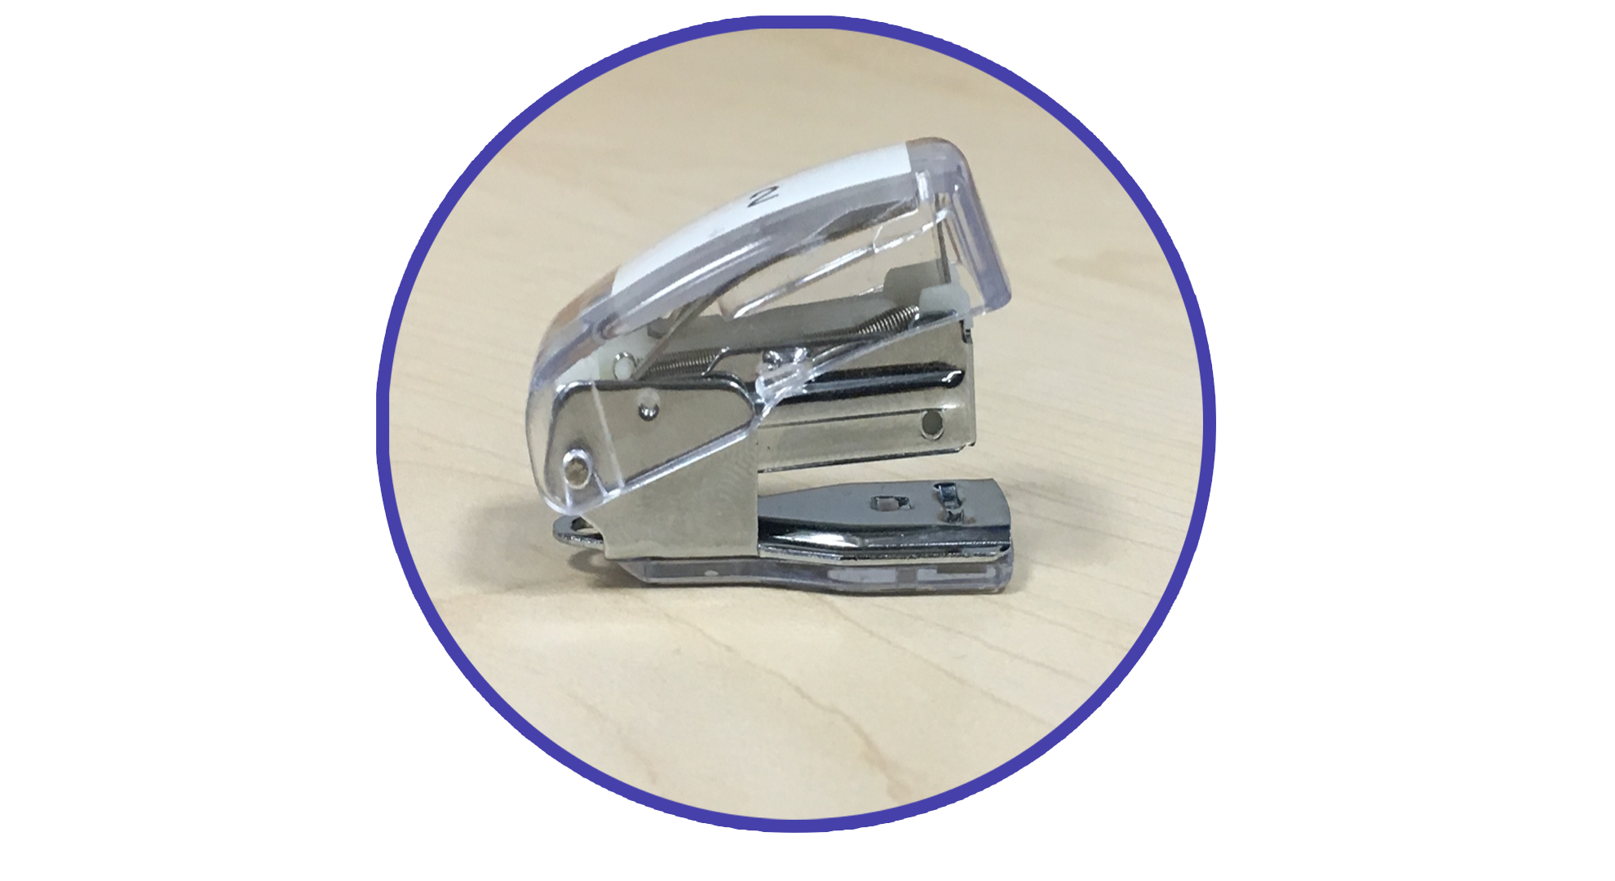
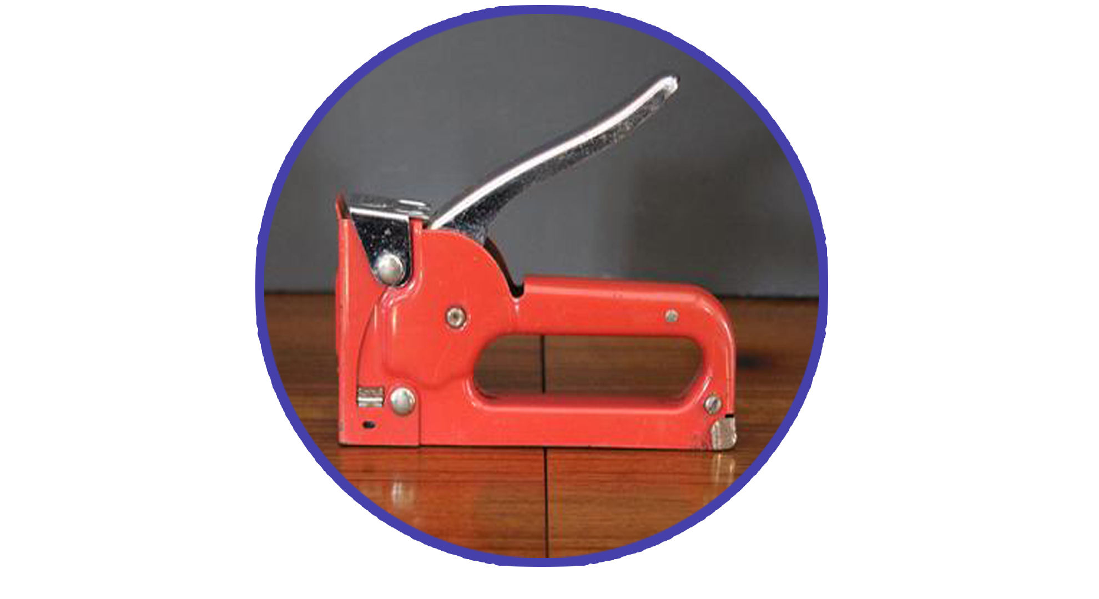
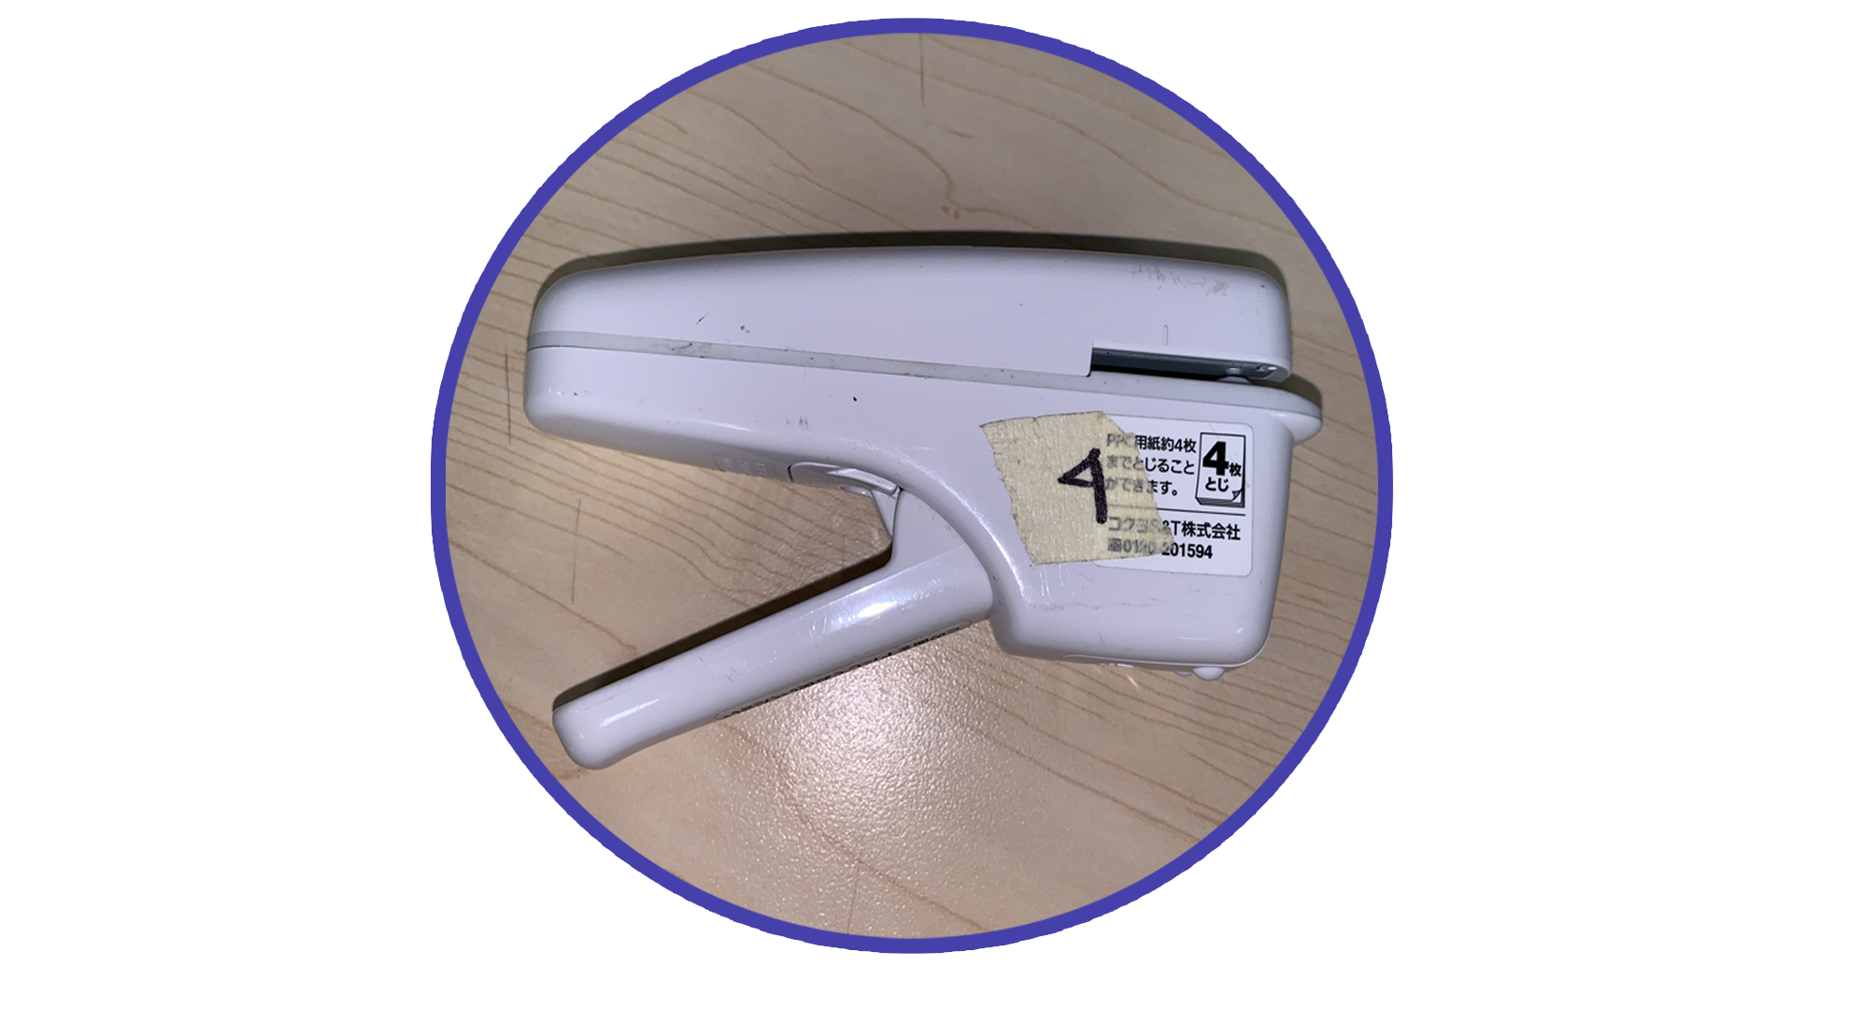
Stapler One
Stapler Two
Stapler Three
Stapler Four

Slide 5
PRODUCT | Stapler One | Stapler Two | Stapler Three | Stapler Four
Functionality | 7 | 6 | 12 | 10
Learnability | 12 | 10 | 6 | 4
Flexibility | 8 | 3 | 6 | 4
Industrial Design | 11 | 10 | 10 | 13
TOTAL | 38 | 29 | 34 | 31

Slide 8
Analysis
Out of the four staplers, we found varying results for each one. Some staplers were considered more practical for its purpose than others, some more learnable, and some more flexible in its use.
When it came to functionality the third stapler was the best one, but when it came to learnability the first stapler proved to be the easiest to use, and it also stole the show for flexibility. And then the fourth stapler proved to be the most aesthetically pleasing.
Each of the staplers proved to have strong points as well as weak points, highlighting the reason why they were made for different purposes.

Slide 9
conclusion
In the previous slides, we showed the results we got from our user testing and came to the conclusion of which stapler was “the best one”.
And when everything got tallied up, at the end of the day the first stapler was what proved to be the “best stapler”.

